Slide 1
Behavioral Flexibility and the Geometry of Neural Representations
Max Pensack
Fusi/ Kiani/ Salzman Co-Lab Meeting
March 19th, 2021

Slide 2
Outline
Behavioral flexibility: two special types
Measures of the geometry of neural representation: what are they good for?
Experimental design: connecting geometry to behavior

Slide 3
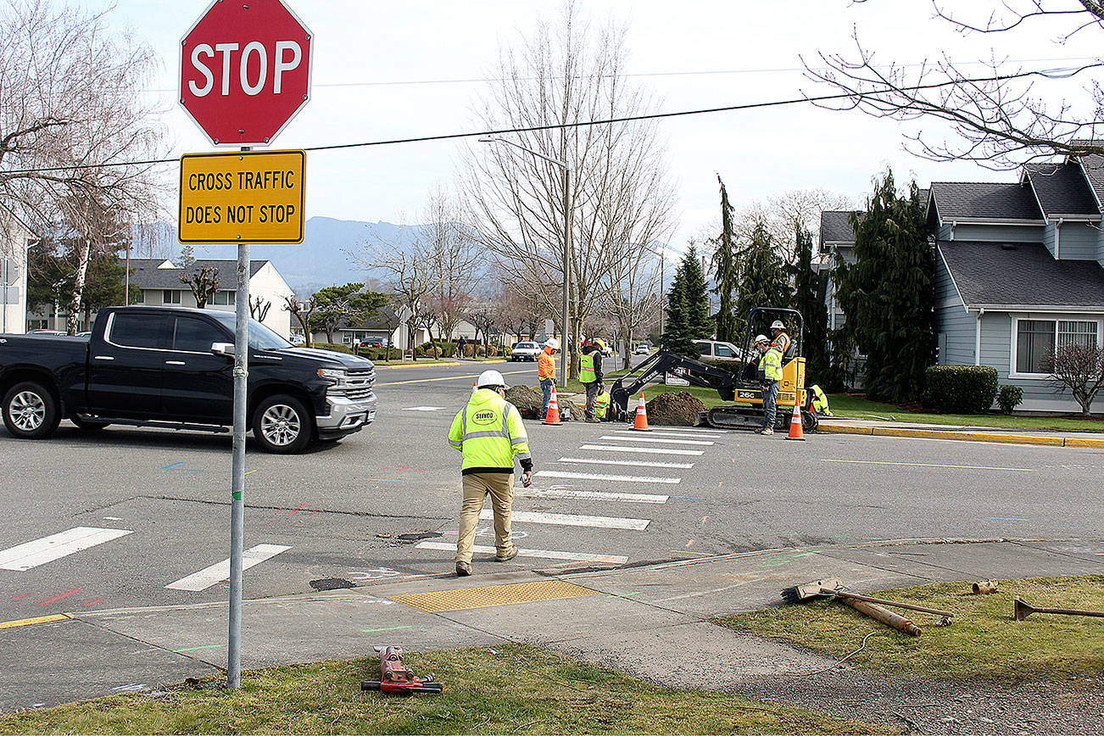
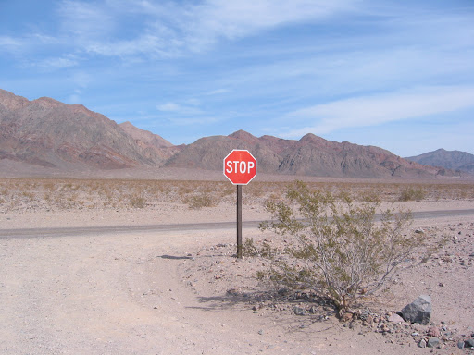
Behavioral flexibility: changing actions & expectations according to situational demands

Slide 4
Two important types of behavioral flexibility
Type 1: relies on remembering all the details of one or more situations to guide behavior (specificity)
Type 2: relies on forming more compact representations that allows you to generalize in novel situations (abstraction)

Slide 5
Shared features vs unique details
Notes:
Shared features allow us to behave similarly in both situations, BUT
Shared features don’t lead to differences in behavior

Slide 6
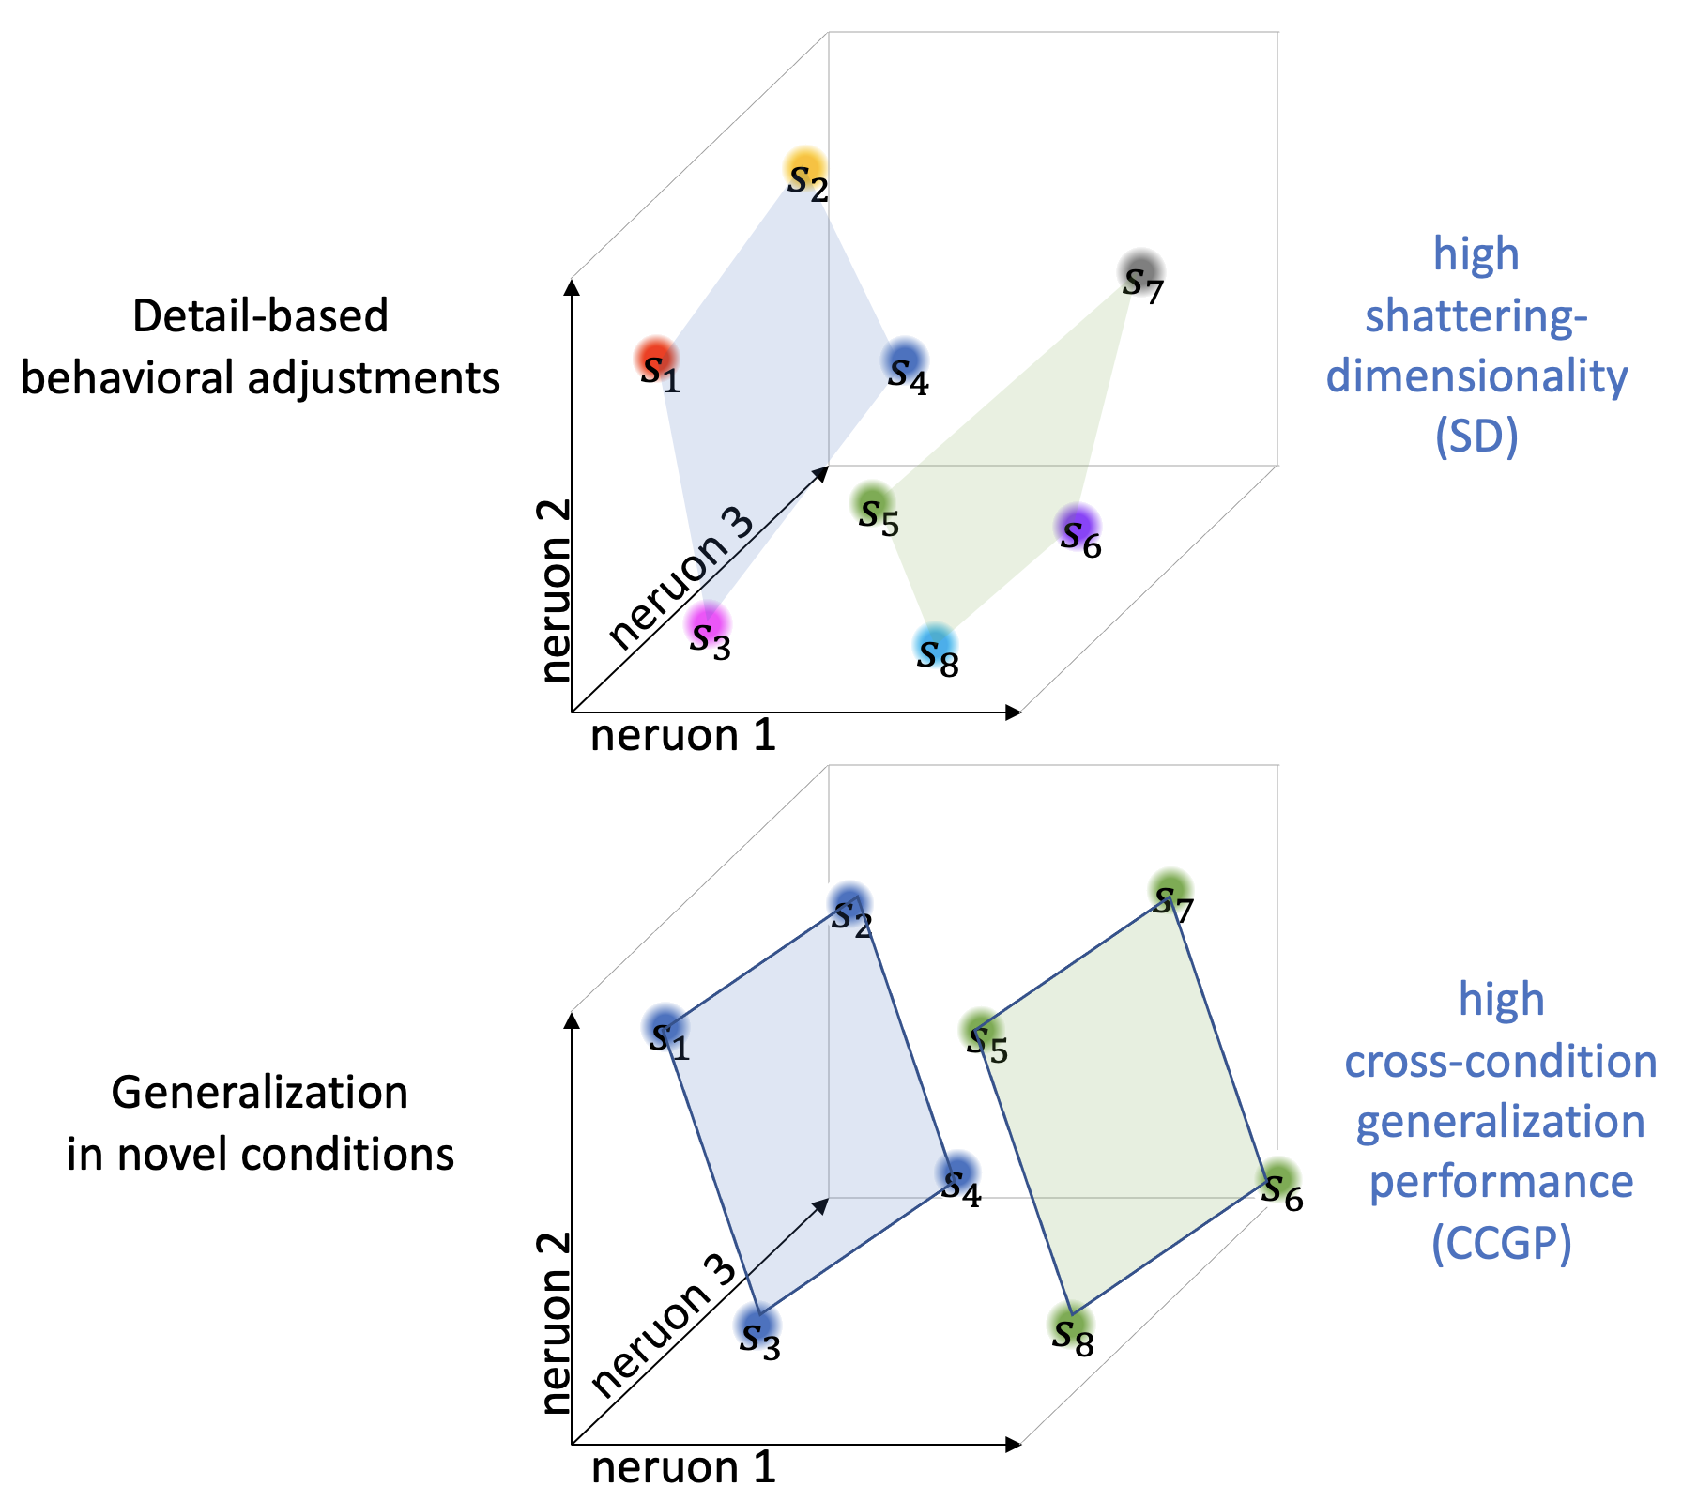
Hypothesis: these two types of behavioral flexibility make distinct demands on neural representations

Slide 7

MNIST example

Slide 8
A simple representation: individual digits

Slide 9
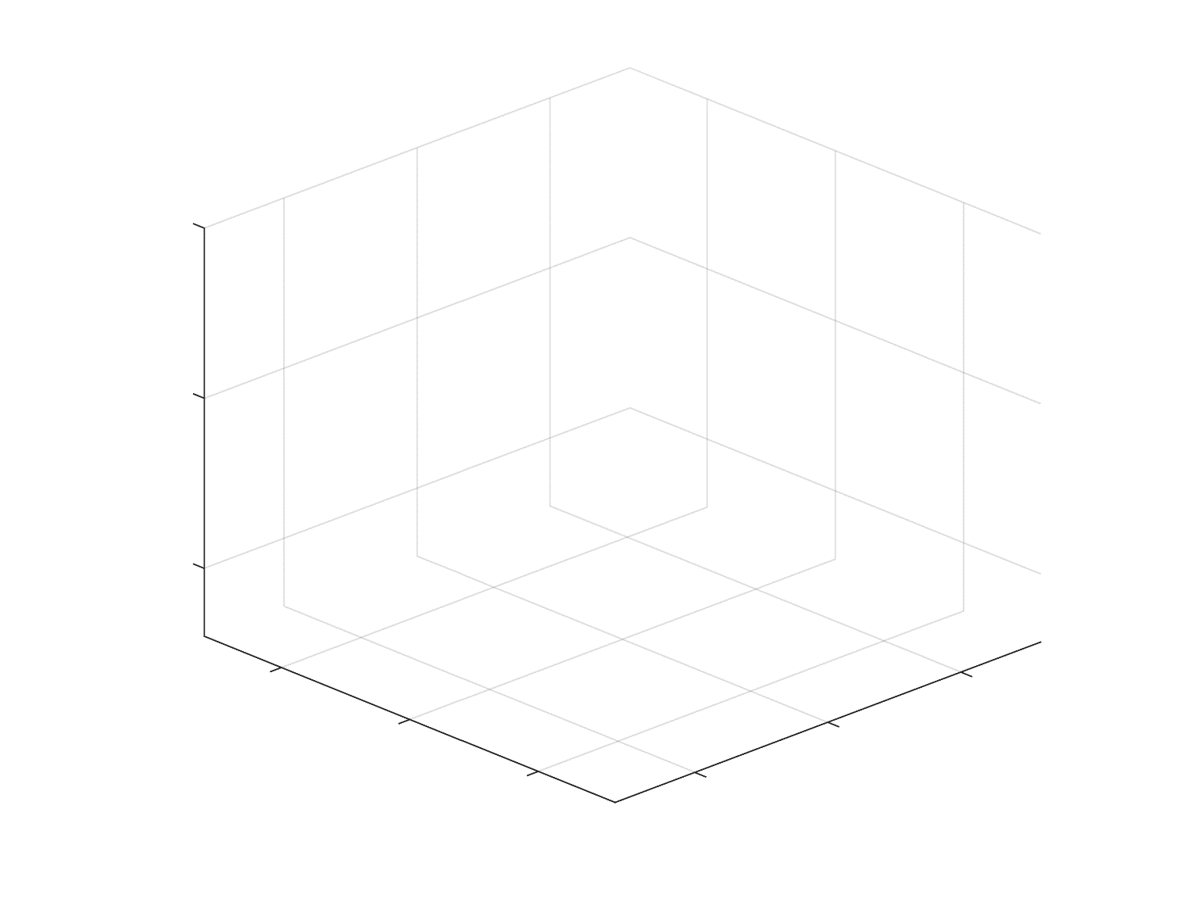
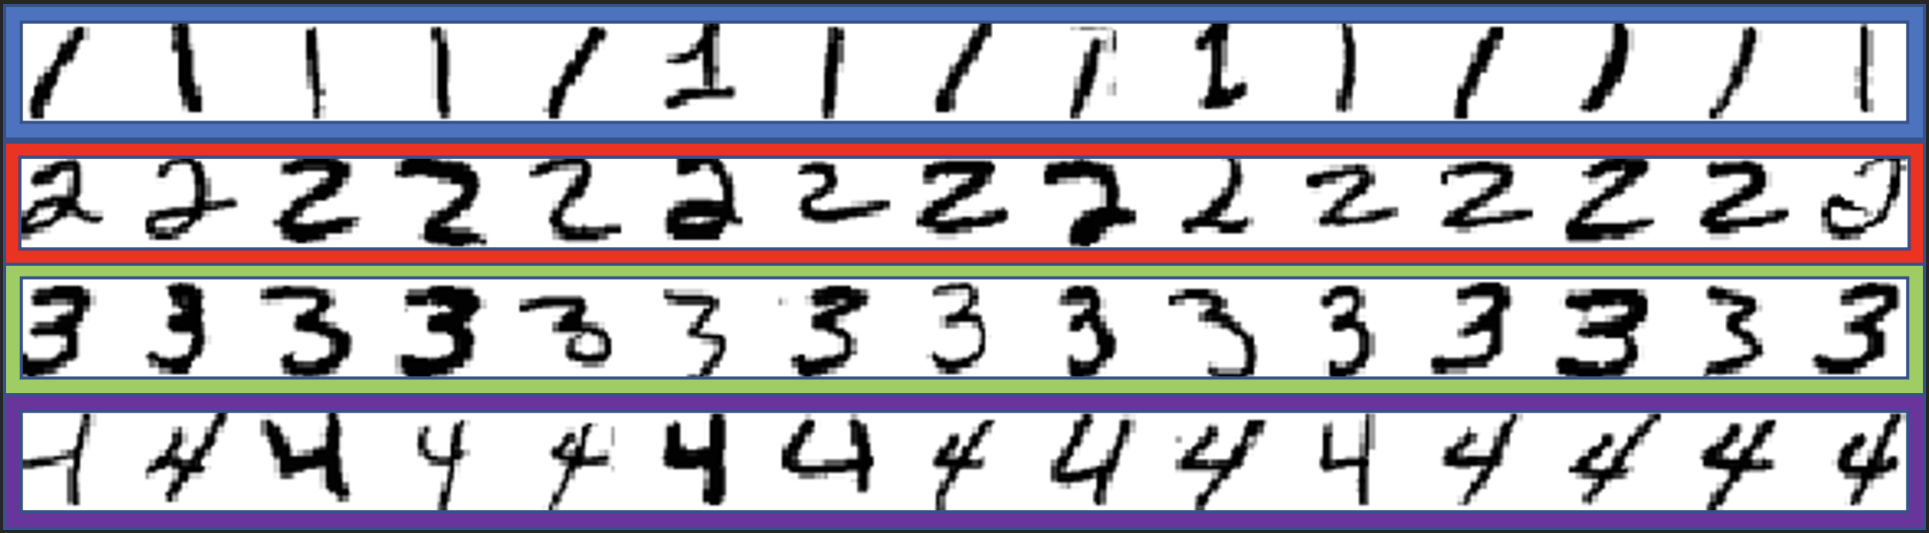
Random selectivity across three neurons
2
f₃
4
3
f₁
1
f₂

Slide 10
A compound representation: even and odd

Slide 11
We could represent this in a simple way…
f₃
even
odd
f₁
f₂

Slide 12
But maybe we don’t need to…
2
f₃
4
3
f₁
1
f₂
Notes:
Plane represents a linear decoder

Slide 13
Likewise, we can separate small from large!
2
f₃
4
3
f₁
1
f₂

Slide 14
How many binary variables can we separate?
(1,2) vs (3,4): Magnitude
(1,3) vs (2,4): Parity
(1,4) vs (2,3): Extremes vs. Intermediates
shattering
dimensionality
1
2
f₃
0.5
4
3
1
f₁
f₂
Rigotti et al. Nature, 2013

Slide 15
Another representation (clustering): even vs odd
shattering
dimensionality
2
4
1
f₃
3
1
0.5
f₁
f₂

Slide 16
But it makes up for this in generalization properties…
Test
2
4
f₃
Train
Test
3
1
Train
f₁
f₂
CCGP: Cross Condition Generalization Performance

Slide 17
Random representations do not generalize well…
Test
2
f₃
Train
Train
4
3
f₁
1
f₂
Test

Slide 18
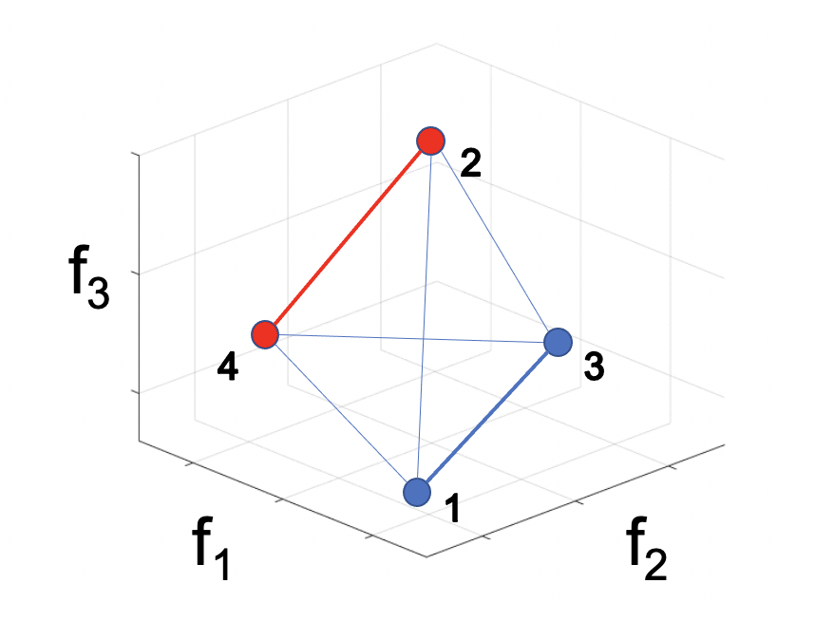
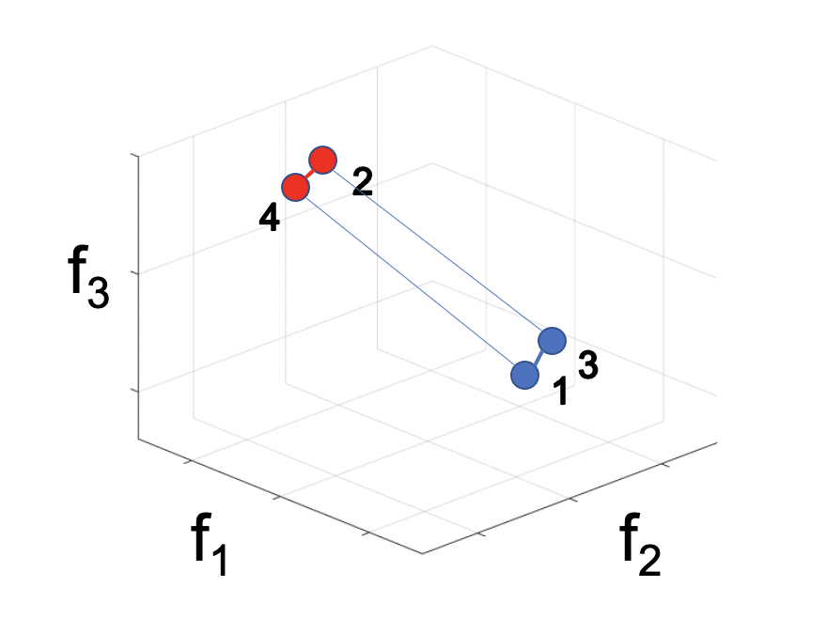
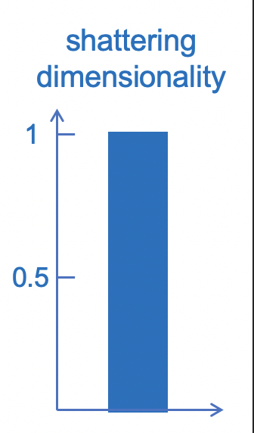
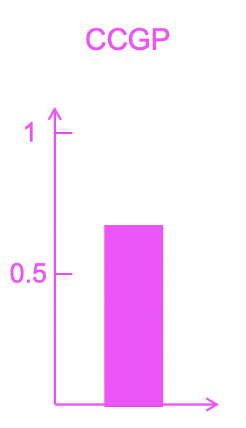
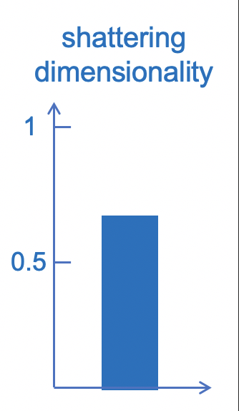
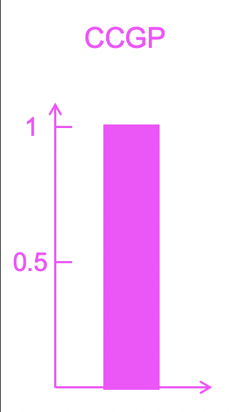
Summary 1: random vs clustering geometries
Parity
Parity

Slide 19
What about CCGP for multiple variables?
Test
2
Test
4
f₃ (parity)
Train
1
Train
3
f₂
Parity
f₁ (magnitude)

Slide 20
What about CCGP for multiple variables?
Train
2
Test
4
f₃ (parity)
Train
1
Test
Magnitude
3
f₂
f₁ (magnitude)

Slide 21
Factorized representations are stable under linear transformations
2
4
f₃ (parity, mag, …)
1
3
f₁ (mag, parity, …)
f₂ (mag, parity, …)

Slide 22
But factorized representations suffer at the level of traditional decoding!
2
4
f₃ (parity, mag, …)
1
3
f₁ (mag, parity, …)
f₂ (mag, parity, …)

Slide 23
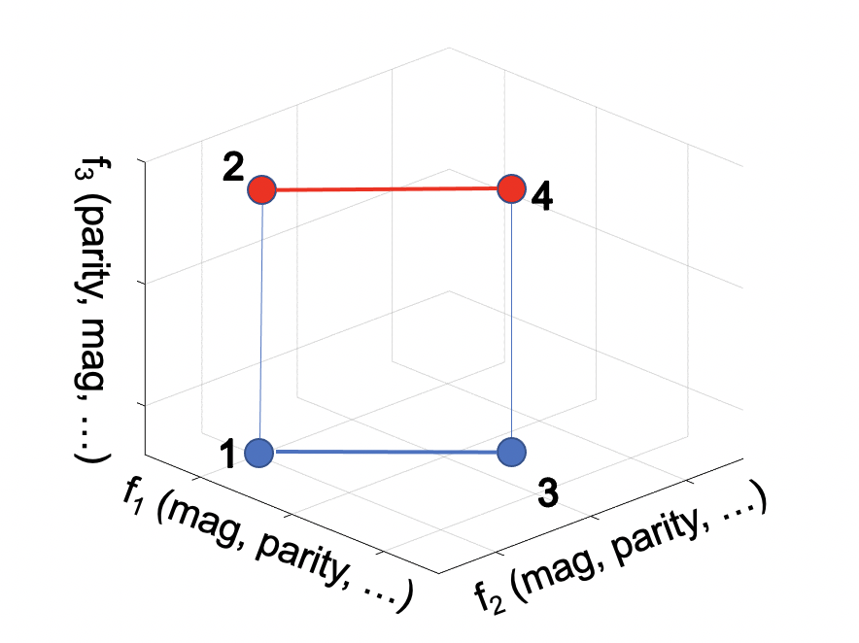
Summary 2: nothing’s perfect
Magnitude
Parity
Parity
Parity

Slide 24
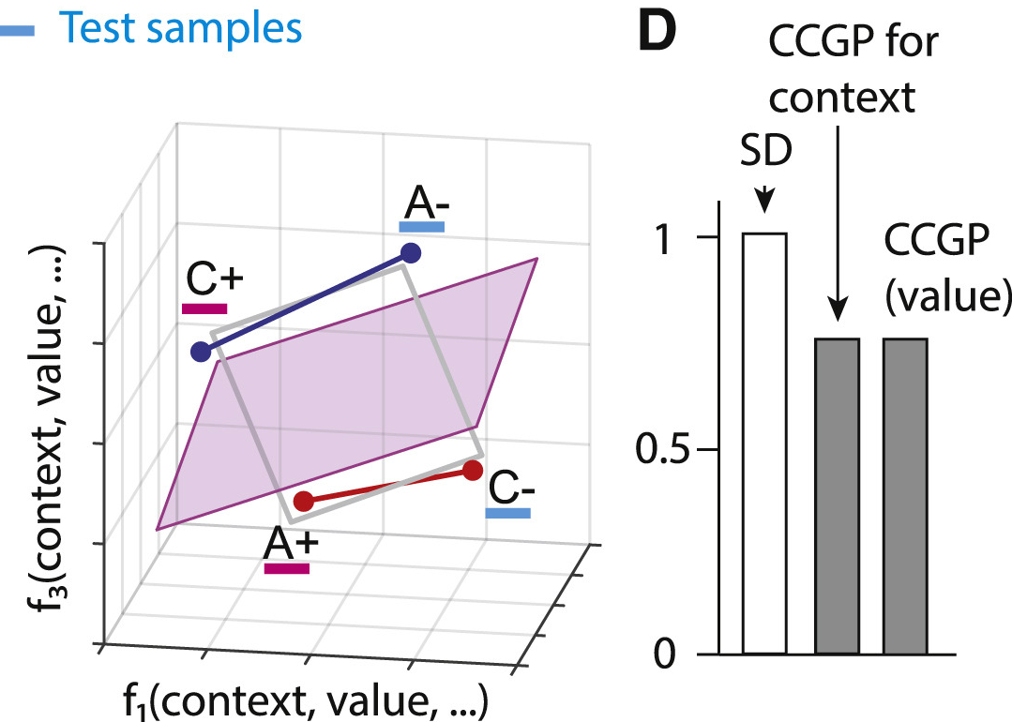
Can we find a compromise? Yes! Amazingly, the brain does this!
Bernardi et al. Cell, 2020
Notes:
A lot like a square, but not a perfect square

Slide 25
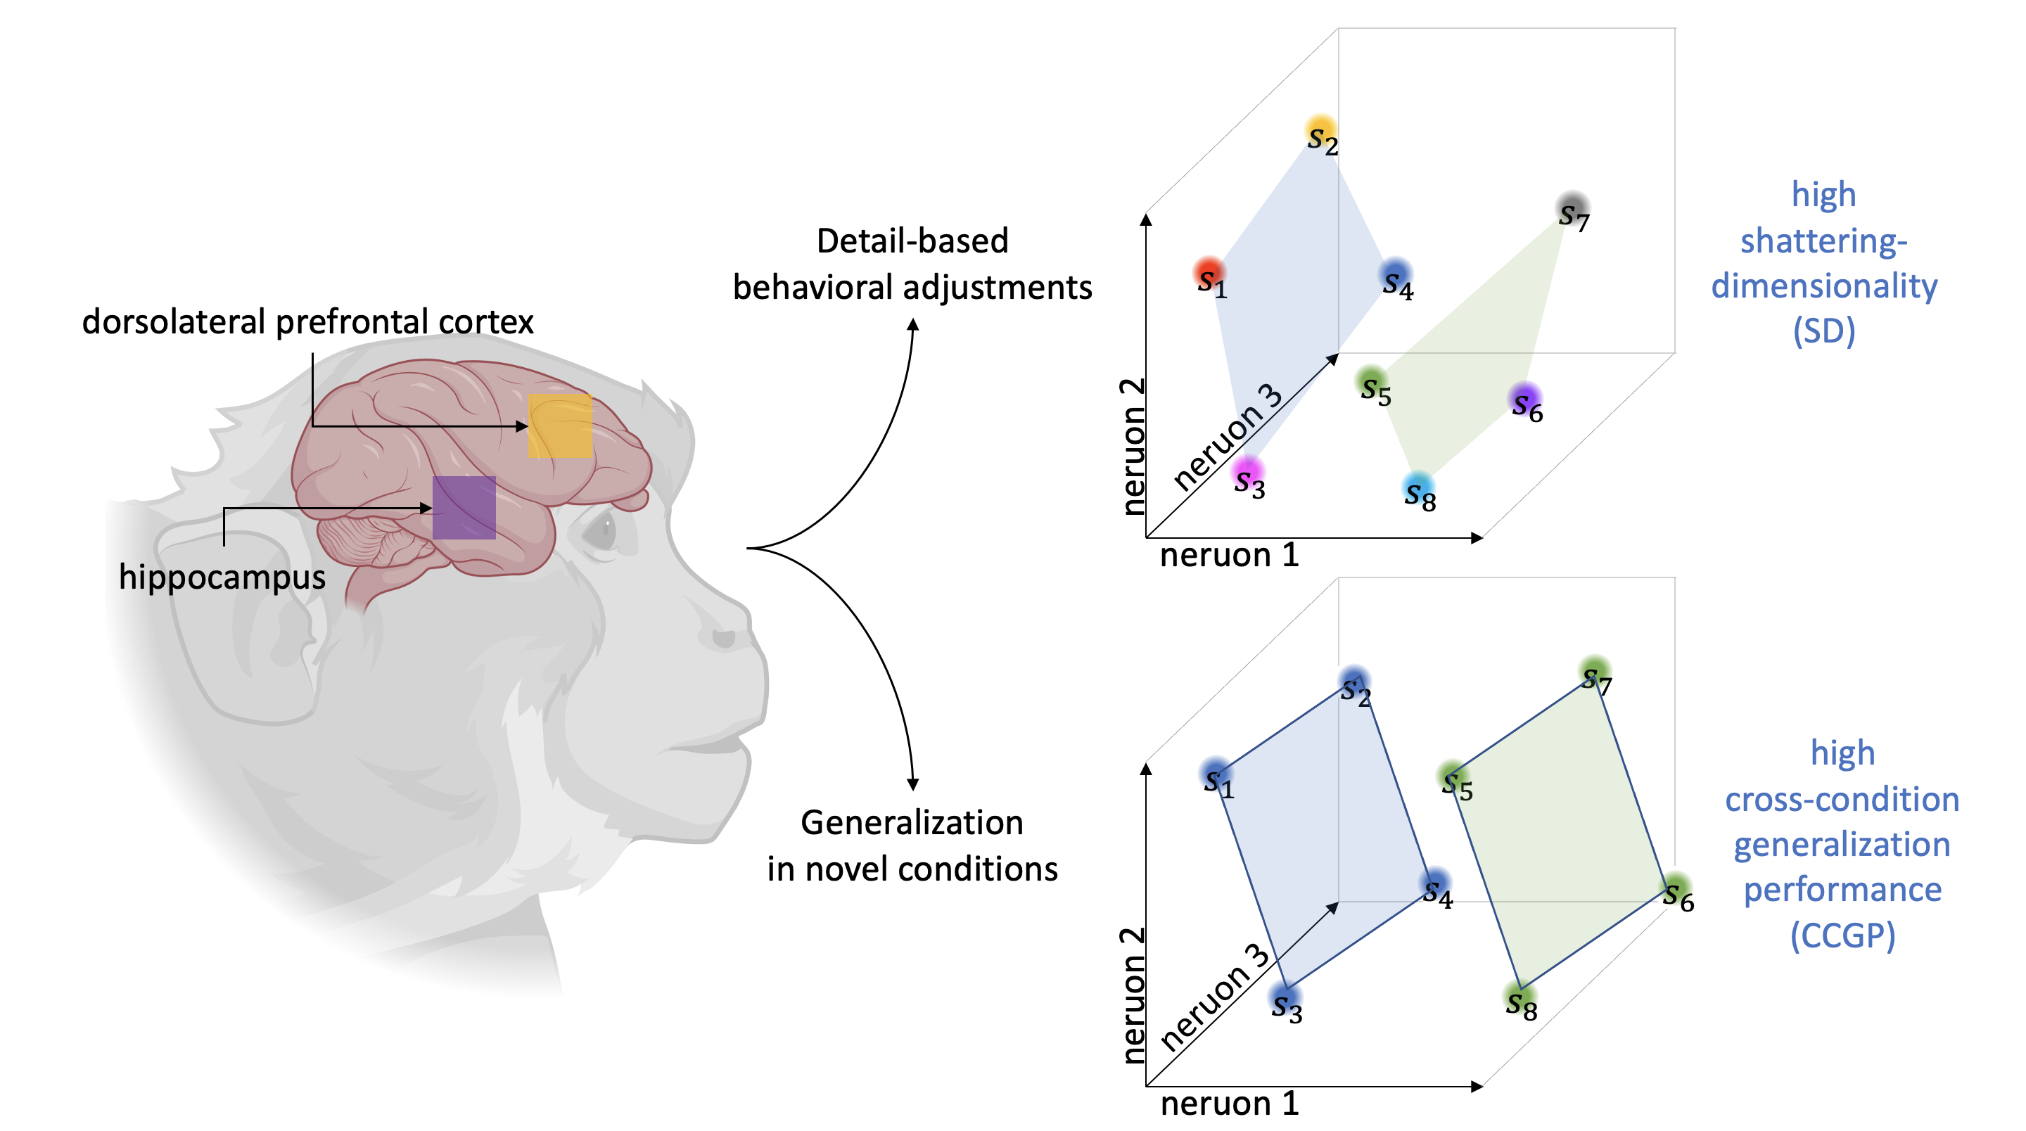
What’s left? Proving this matters for behavior!
Notes:
Wanted to build on the task in Bernardi et al.
So we designed a unified task with 2 kinds of experimental conditions, where
1 demands maintaining each of 8 experimental conditions in a geometry with high SD
1 demand maintaining the variable CONTEXT in a geometry with high CCGP

Slide 26
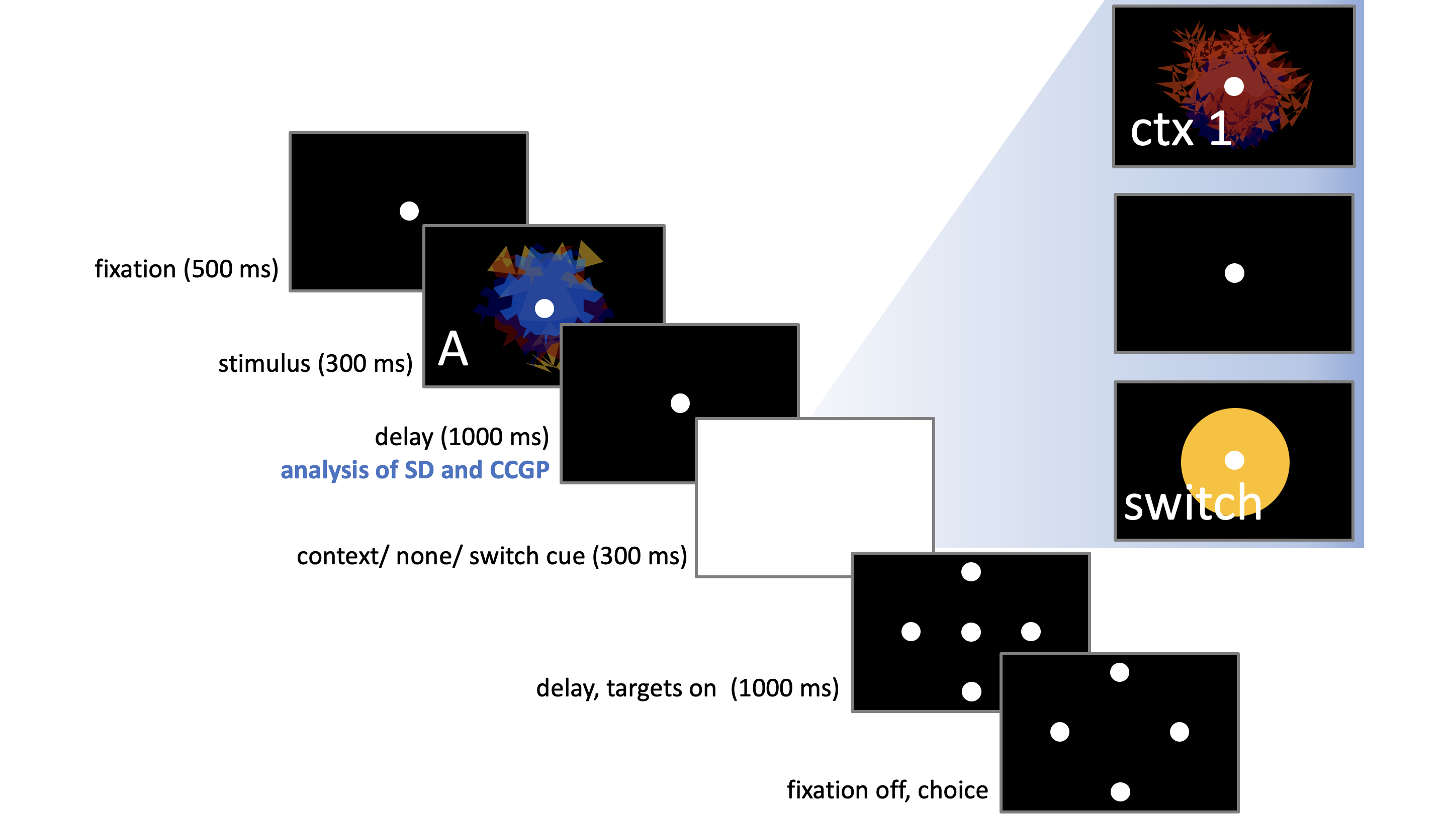
Experimental Design
First 8 trials
40-60 trials
Last trials

Slide 27
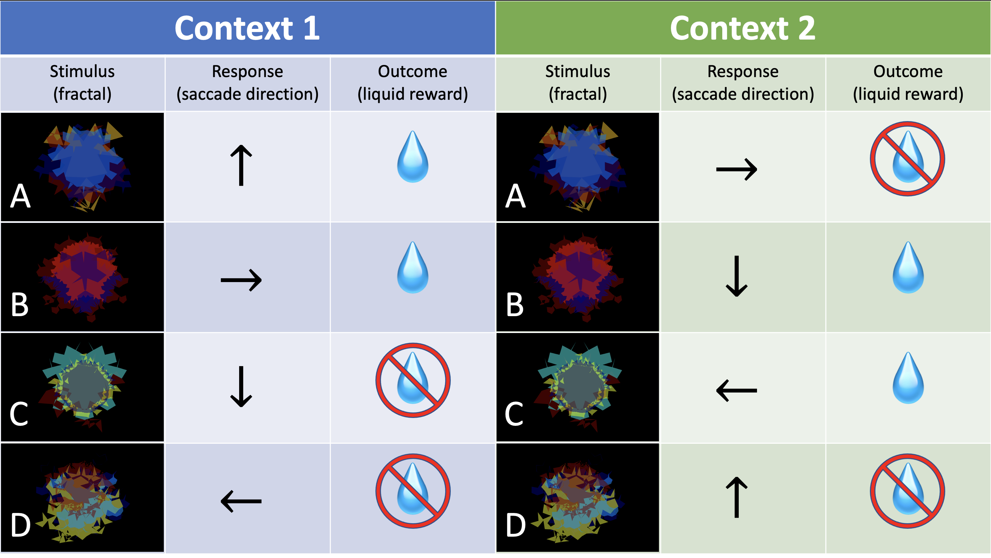
(even more complicated) S-R-O Mappings
Notes:
When switching, we don’t want the animals to do the OPPOSITE operant response

Slide 28
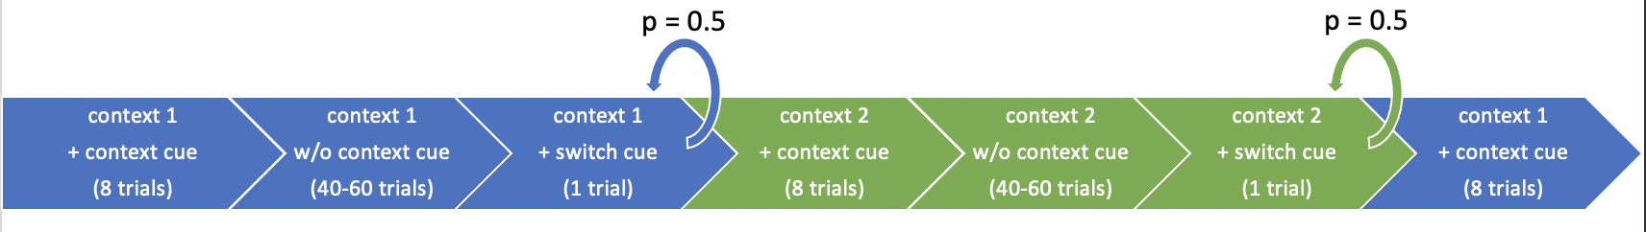
Analysis of shattering dimensionality
Key time interval
Notes:
Switch cue induces animal to represent each of the 8 experimental conditions with a different pattern of neural activity

Slide 29
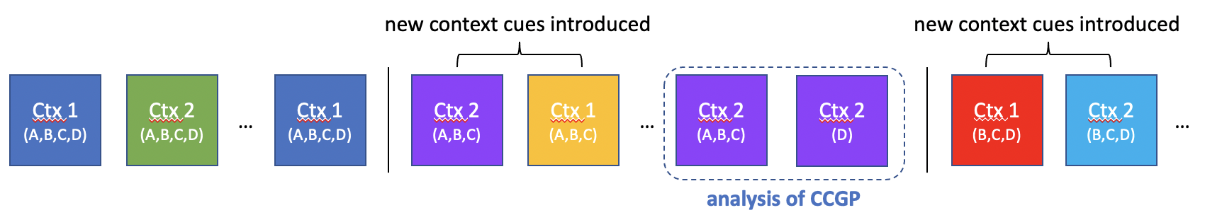
Analysis of CCGP
Key time interval

Slide 30
Generalizing for the variable context
B
B
B
B
A
A
A
A
f₃
f₃
D
D
D
D
C
C
C
C
f₁
f₂
f₁
f₂

Slide 31
Expected Outcomes (guesses)
SD will correlate more with behavior in DLPFC vs hippocampus
CCGP will correlate with behavior in both DLPFC and hippocampus, though this might vary by brain area with animal’s learning rates

